Slide 1

SOLELY FOR THE PURPOSE OF FORAGE WORK EXPERIENCES
WEB SCRAPPING TO GAIN COMPANY INSIGHTS
SHUBHIKA RANJAN
24 JAN 2024

Slide 2
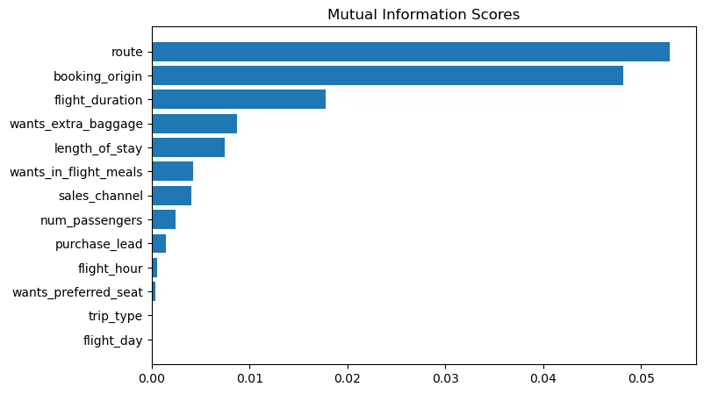
Predictive Model to Understand factors that can influence customer “buying” behavior
SOLELY FOR THE PURPOSE OF FORAGE WORK EXPERIENCES
Trained the dataset with Random Forest Classifier
 | Training set | Testing set
ACCURACY | 84.84% | 85.37%
AUC score | 0.5527 | 0.5678
We need to improve the AUC (Arear Under the ROC curve) score to show improved model performance
Mutual information score in predictive modeling helps us understand the relationship between two variables by measuring the amount of information one variable provides about the other.
Specifically, in the context of feature selection, mutual information score helps identify which features are most informative for predicting the target variable.
Top 5 features affecting customer buying behavior:
1. route
2. booking_origin
3.flight_duration
4.wants_extra_baggage
5. length_of_stay

